Slide 1
The Perceptron

Slide 2
Agenda
The Perceptron – Forward Propagation
Common Activation Functions
Importance of Activation Functions
The Perceptron - Example

Slide 3

Perceptron / Neuron

Slide 4
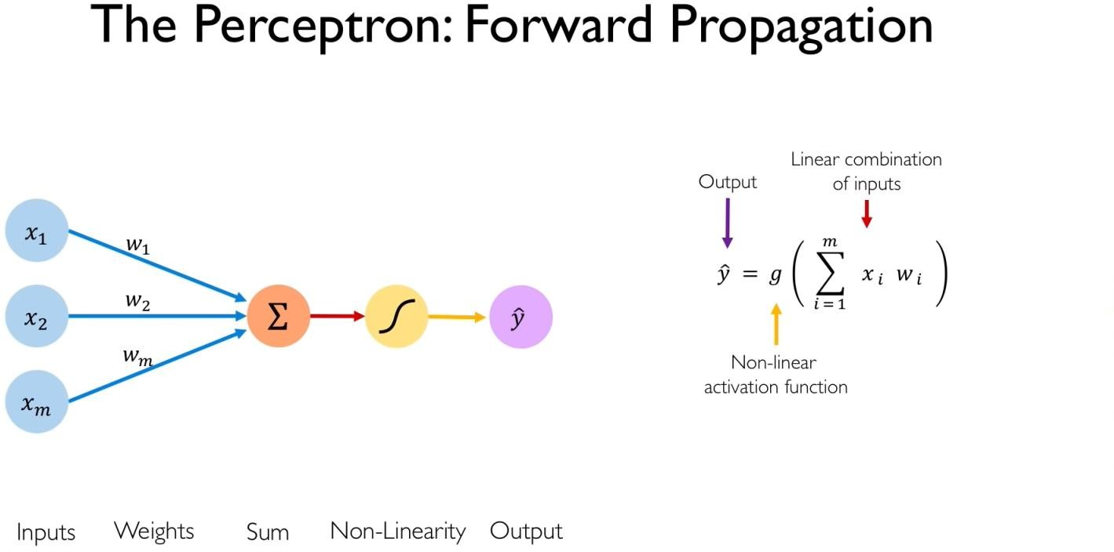

Slide 5
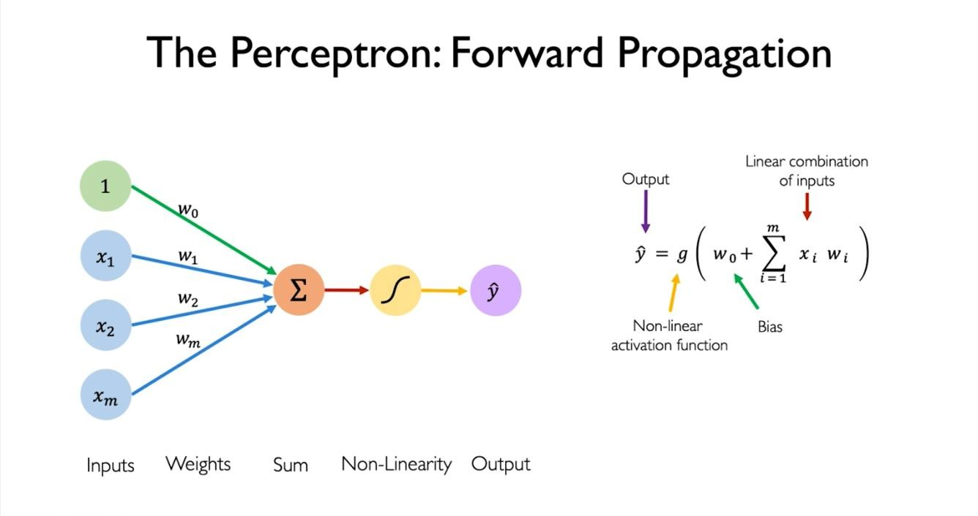
Notes:
The bias is added to neural networks to enable flexibility in decision-making and to shift the activation function, allowing for better model performance.

Slide 6
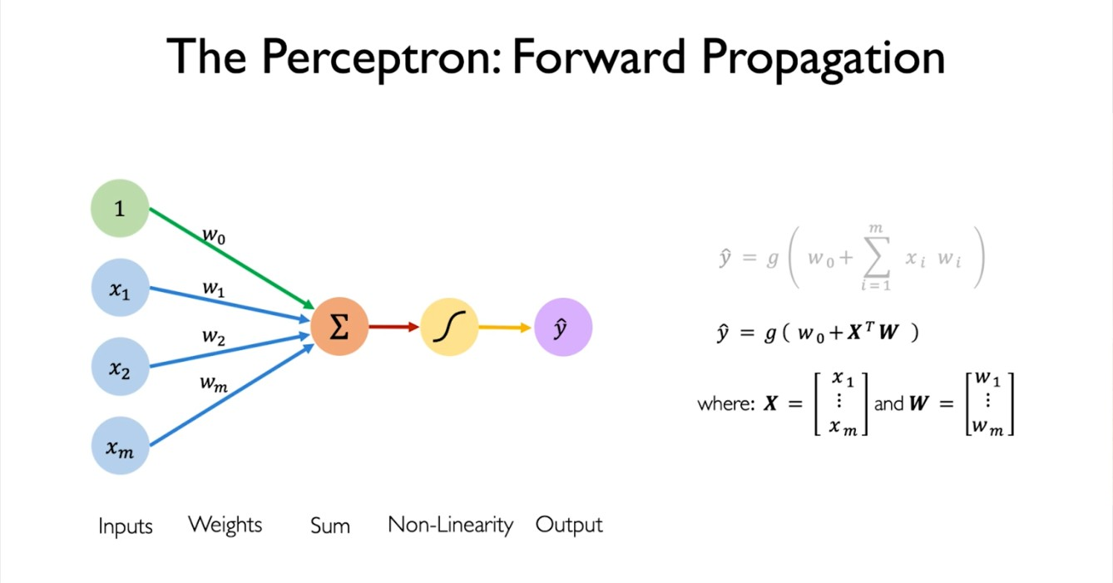

Slide 7
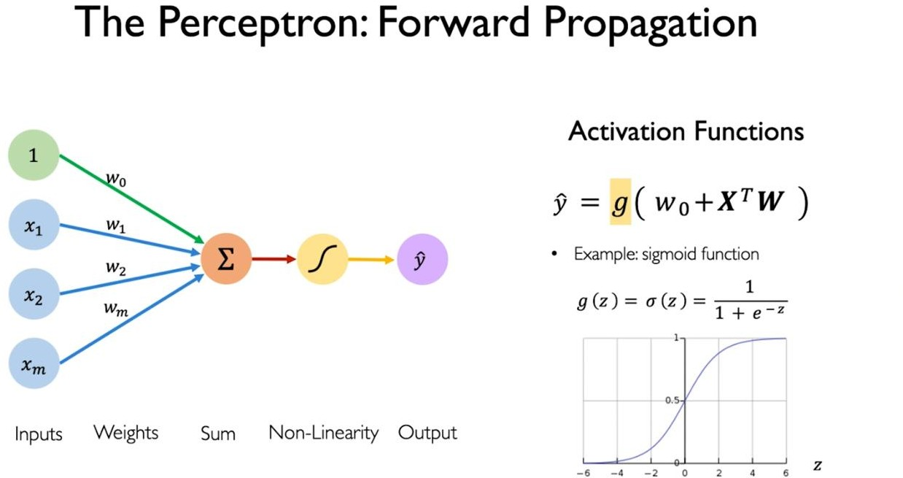

Slide 8
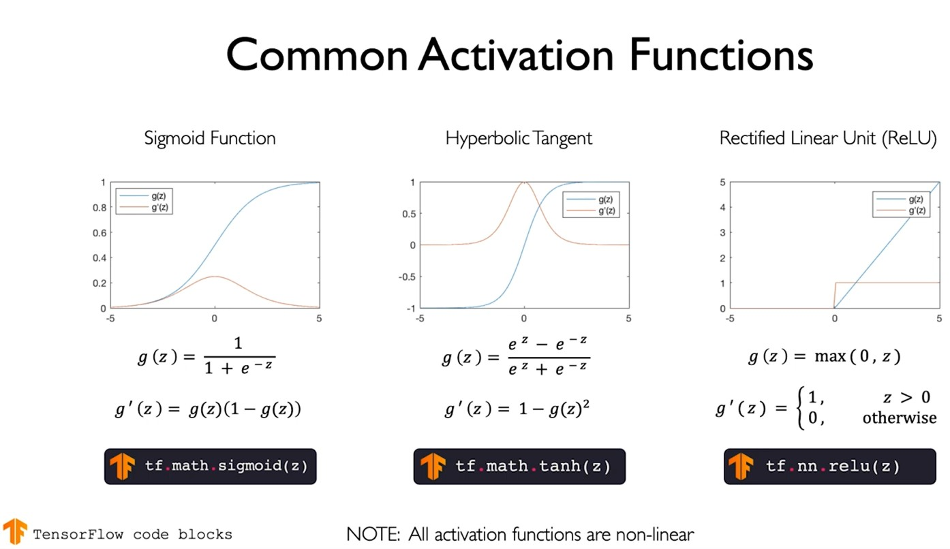
Notes:
Sigmoid Function:
The sigmoid function maps any real-valued input to a range between 0 and 1. It is commonly used in binary classification tasks, where the output represents probabilities.
Hyperbolic Tangent (tanh):
Similar to the sigmoid, the tanh function maps input to a range between -1 and 1. It is symmetric around the origin and is useful for hidden layers in neural networks.

Slide 9
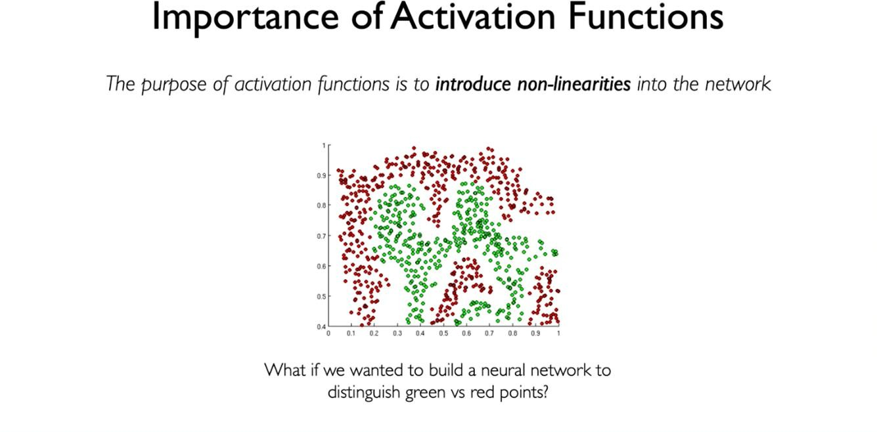
Notes:
Activation functions introduce nonlinearity into the network, enabling it to learn and approximate complex, nonlinear relationships in data. Without nonlinear activation functions, neural networks would only be able to represent linear transformations of the input, severely limiting their expressive power.

Slide 10
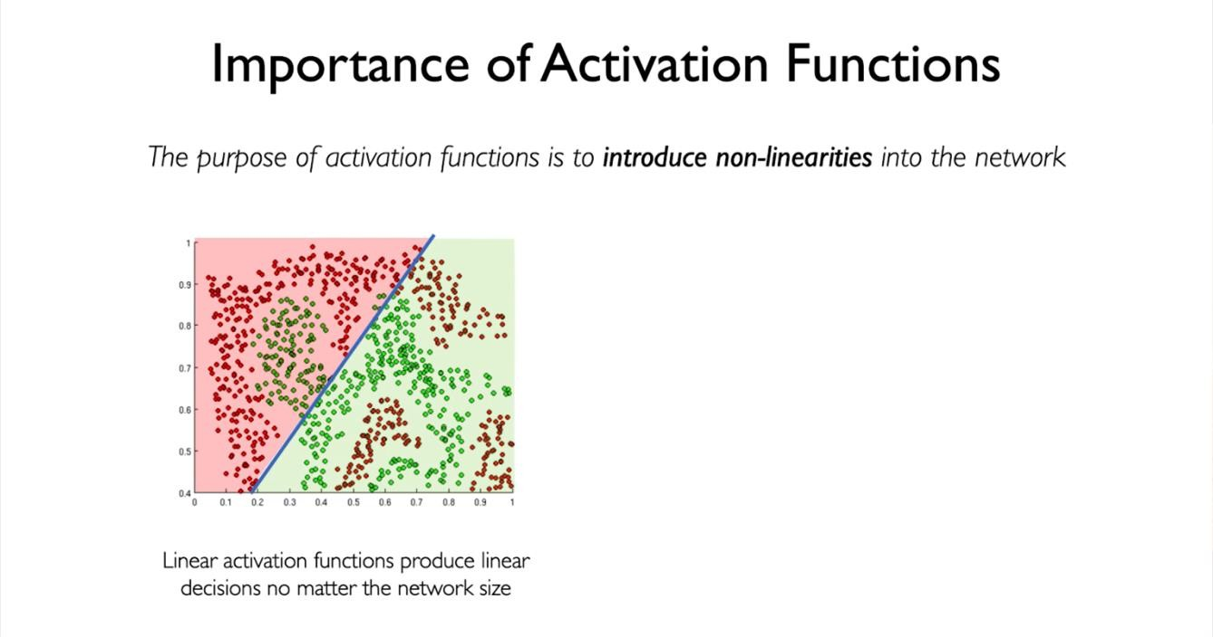

Slide 11
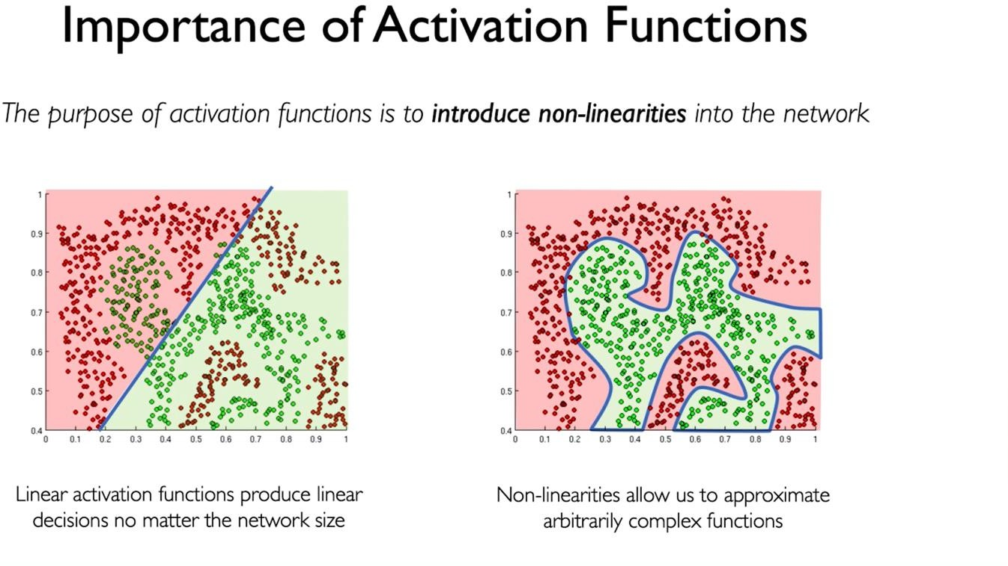

Slide 12
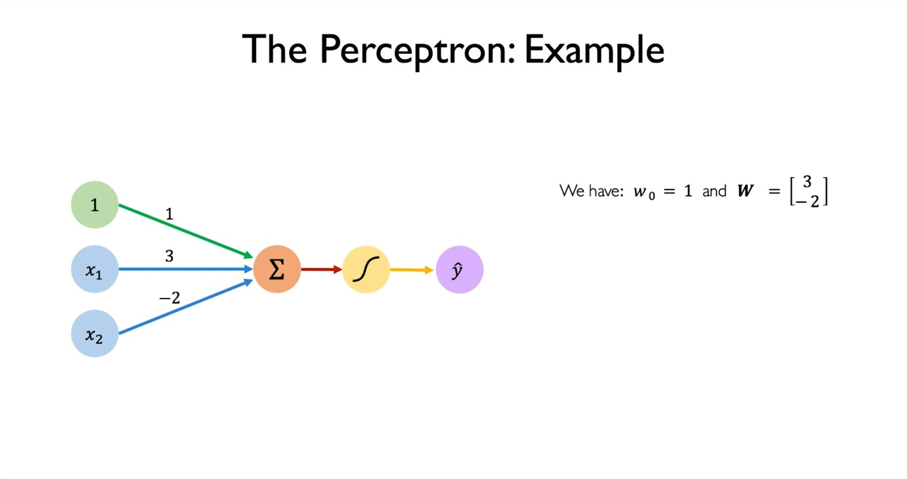

Slide 13
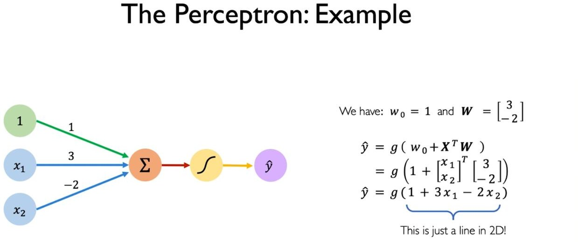

Slide 14
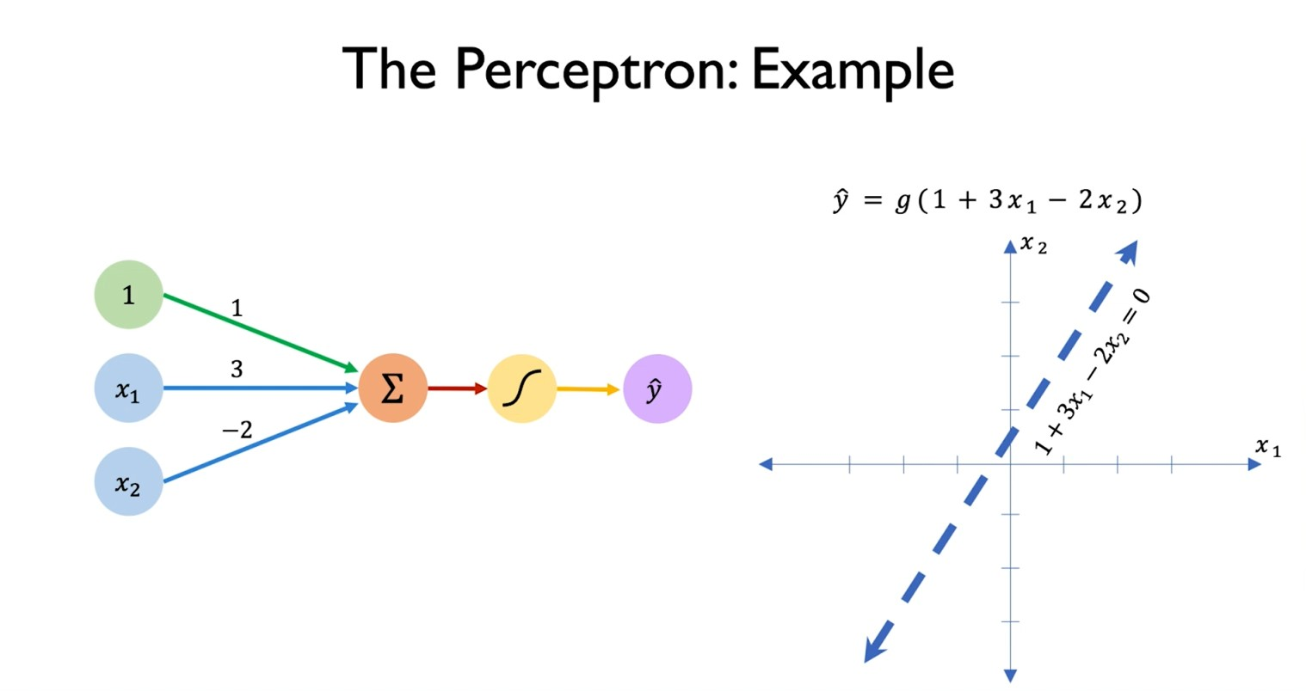

Slide 15
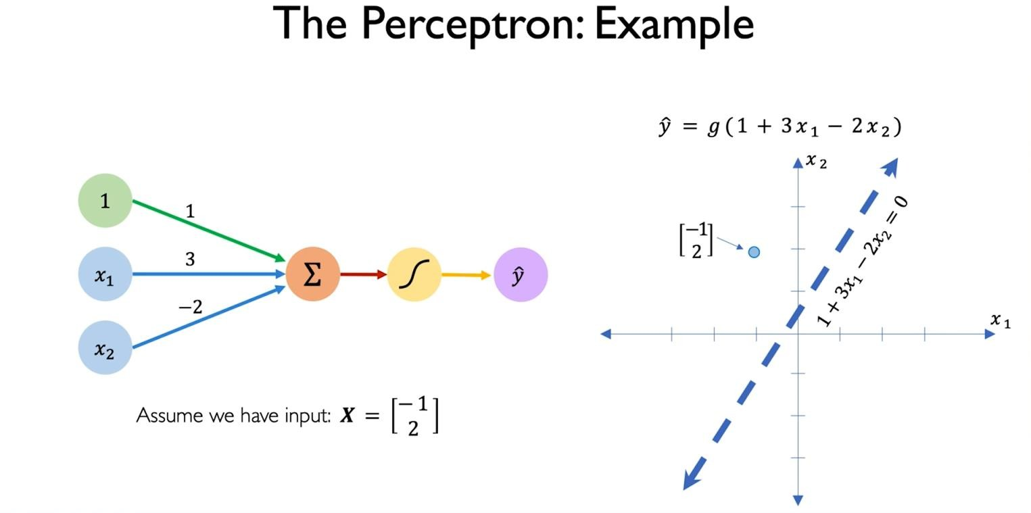

Slide 16
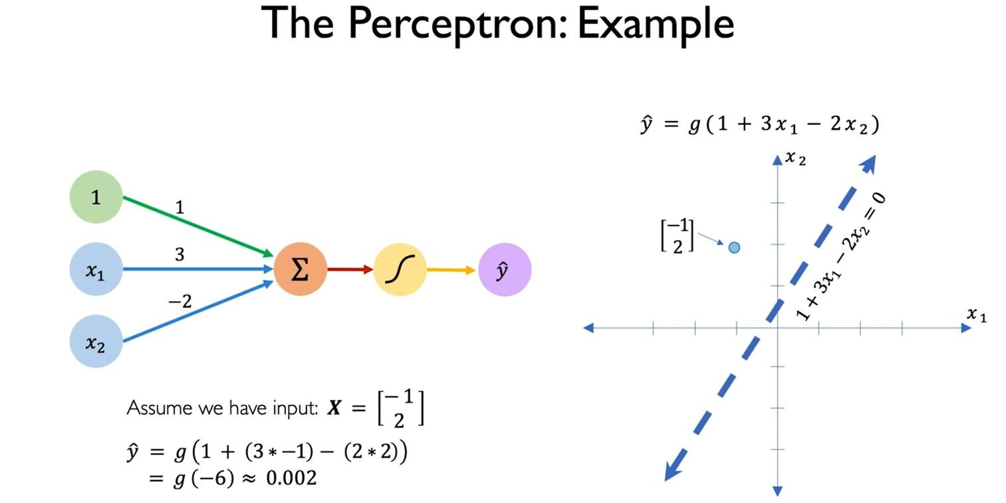

Slide 17
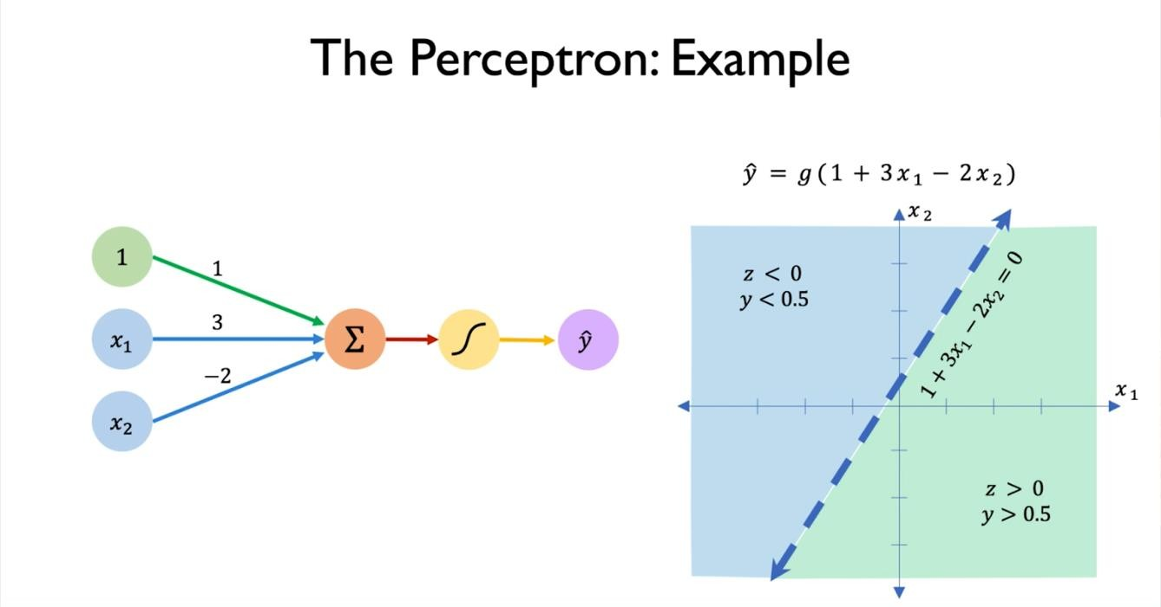

Slide 18
Thanks!

